Slide 1
LCS 311: Multilingualism
1
Lecture 8
Introducing Language Policies
Prof. B. Antia & Ms G. Hartman
Based on pages 27-31 of the Course Reader

Slide 2
Previous lecture (7): Multilingualism and Democracy
2
What is democracy?
What are the pillars (ingredients) of democracy?
The importance of multilingual policies/practices in a democracy
Impediments to multilingual policy in a democracy?
Major consequences/disadvantages of monolingual policies in a democracy

Slide 3
This Lecture (8):
What is language policy (LP)?
Motivations for language policies
The Language Policy Framework for Public Higher Education Institutions (replacing the South African Language Policy for Higher Education); UWC’s Language Policy
Stages in the life-cycle of a language policy and planning
Types of language planning
Assessing Language policies: orientations of language policy writers
3

Slide 4
Language Policy
4
What is a language policy?
“In most political entities, language policy (LP) is the primary mechanism for organizing, managing and manipulating language behaviors as it consists of decisions made about languages and their uses in society. It is through LP that decisions are made with regard to the preferred languages that should be legitimized, used, learned and taught in terms of where, when and in which contexts” (Shohamy, 2006: 45).

Slide 5
Language policy…cont’d
5
The “decisions [that are] are made with regard to the preferred languages that should be legitimized, used, learned and taught in terms of where, when and in which contexts” (Shohamy, 2006: 45) can be contained in a document called language policy, in statements related to language in some other regulatory document, in the pronouncement of a powerful body, or in the action or practices of a powerful group, etc.
In other words, a language policy may come in several forms: as a written document called ‘language policy’; as a statement on language use in a document related to education, health, the public service, a particular business, the police and other security services, etc.; as a pronouncement on language by a competent body or person (that is powerful enough to make such a declaration); the practice of such a competent person or body or of an even wider group; etc.

Slide 6
Motivations for Language Policy (based on Ager 2001)
6
Identity: Identity has to do with the ways in which people position themselves or are positioned by others. A language policy (provision) may be motivated by the desire to position certain group(s) of people relative to others (e.g. as being (not) equally indigenous/legitimate inhabitants of a given country); or by a desire to impose a new national/ cultural/linguistic identity on people - e.g. read on “Russification” on Google.
Ideology (of language): A language policy may derive (at least in part) from a desire to manage worldviews towards the languages in a given context (e.g. to promote a belief that Language-X is superior to others; is God-given, etc.)
Insecurity. Policy may be motivated by fear, e.g. (i) of a particular language being ‘contaminated’ (see ideology) above; (ii) that a certain language constitutes a threat to other languages of a community, such that over time communities speaking ‘threatened’ languages lose these languages; (iii) that socioeconomic opportunities may not be available to a local community if there is no policy that uses language for protectionist purposes (recall elite closure).

Slide 7
Motivations …cont’d
7
Inequalities: Social inequalities are unfair and avoidable differences between groups. For a language policy, the unfairness to be addressed may have to do with (a) access of a group to opportunities; (b) denigration or stigmatization of a group (which may be defined in terms of health, gender, ethnicity/origin, religion, profession, etc.); (c) the historical marginalization of certain languages from high function domains; etc. Which of these do you find in the SA Constitution?

Slide 8
The Old: South African Language Policy for Higher Education (LPHE 2002)
8
All HEIs must develop language policies that advance the official SA languages
LPHE notes:
“Language has been and continues to be a barrier to access and success in higher education; both in the sense that African and other languages have not been developed as academic/scientific languages and in so far as the majority of students entering higher education are not fully proficient in English and Afrikaans.”
“The challenge facing higher education is to ensure the simultaneous development of a multilingual environment in which all our languages are developed as academic/scientific languages, while at the same time ensuring that the existing languages of instruction do not serve as a barrier to access and success. The policy framework outlined below attempts to address this challenge.”

Slide 9
SA Language Policy for Higher Education …cont’d
9
As a result, LPHE requires that:
The Minister of Education must, in accordance with Section 27(2) of the Higher Education Act of 1997, determine language policy for higher education. Subject to the policy determined by the Minister, the councils of public higher education institutions, with the concurrence of their senates, must determine the language policy of a higher education institution and must publish and make such policy available on request.

Slide 10
The new: The Language Policy Framework for Public Higher Education Institutions 2020
10
Rationale: in spite of LPHE of 2002, “little progress made in exploring and exploiting the potential of African languages in facilitating access and success in higher education institutions”
Sample policy statements:
This policy framework commits to the development and study of all official South African languages especially those which were historically marginalised, including the Khoi, Nama and San languages. Institutions are required to develop language plans and strategies indicating mechanisms they will put in place to enhance the development and promotion of indigenous African languages as centres of research and scholarship.
The policy framework recognises the need to develop competencies and capacity in South African sign language consistent with the Use of Official Languages Act, 2012 (Act No.12 of 2012).

Slide 11
The new: The Language Policy Framework for Public Higher Education Institutions 2020 ...cont’d
11
Scholarship, Teaching and Learning: higher education institutions must demonstrate in their language plans the investment they have made or will make in the development of official languages into languages of teaching and learning, scholarship and research. This is in addition to the LOTL.
Communication: All official internal institutional communication must be conveyed in at least two official languages other than English, as a way of cultivating a culture of multilingualism.
Higher education institutions must assist in preparing sufficient language teachers, interpreters, translators and other language practitioners, to serve the needs of South Africa’s multilingual society.
National enablers
International enablers: BAQONDE: https://baqonde.usal.es

Slide 12
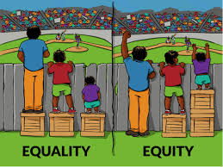
UWC’s Language Policy
12
Preamble: The University of the Western Cape is a multilingual university, alert to its African and international context. It is committed to helping nurture the cultural diversity of South Africa and build an equitable and dynamic society. This language policy relates to one aspect of that commitment. It attempts to guide institutional language practice so that it furthers equity, social development, and a respect for our multilingual heritage.
https://publichealthonline.gwu.edu/blog/equity-vs-equality/

Slide 13
UWC’s LP…Cont’d
13
UWC’s official languages: Afrikaans, English and isiXhosa
Policy provisions in 5 major areas
Languages of Teaching, Learning and Assessment
Languages used in lectures, tutorials and practicals
Languages used in the setting of tasks, assignments, tests and examinations
Languages used in writing tasks, assignments, tests and examinations
Languages in which texts are available
Languages students use in self-directed learning processes and activities
ii. Access to Academic and Professional Discourse
iii. Promoting Multilingualism
iv. Languages of Internal Communication
v. Language of External Communication

Slide 14
UWC LP: Languages of Teaching, Learning and Assessment
14
Languages used in lectures, tutorials and practicals
Lectures, tutorials and practicals for any module will be delivered in the language formally approved by the Faculty concerned, in accordance with the spirit of the policy. If lecturers are competent users of other languages, they are encouraged to use these languages in addition to main language of teaching, if such a practice facilitates communication or discussion.
Languages used in the setting of tasks, assignments, tests and examinations
Regarding the languages used in the setting of tasks, assignments, tests and examinations, English, Afrikaans and Xhosa should be used wherever it is practicable to do so.
Languages used in writing tasks, assignments, tests and examinations
Unless otherwise negotiated between a student or a class and a lecturer, the language in which tasks, assignments, tests and examinations should be completed shall be English.

Slide 15
Languages of Teaching, Learning and Assessment…cont’d
15
Languages in which texts are available
Regarding the languages in which texts are available, efforts should be made to provide alternatives and options in Afrikaans, English and Xhosa wherever it is practicable and academically desirable to do so. Texts here refers to support materials such as course outlines, lecture notes and computer courseware.
Languages students use in self-directed learning processes and activities
Regarding the languages students use in their self-directed learning processes and activities, departments should actively seek to appoint some student tutors who can assist students in Xhosa and/or Afrikaans, as well as English.

Slide 16
UWC LP: Access to Academic and Professional Discourse
16
All students will have access to entry-level courses aimed at strengthening their English oral and aural communication skills and improving their academic literacy in English.
All students will have access to support services to assist them in developing their academic literacy in English.
e.g. Writing Centre at UWC

Slide 17
UWC LP: Promoting Multilingualism
17
The university undertakes to make language acquisition courses in Afrikaans, English and Xhosa available to both administrative and lecturing staff.
All students will be encouraged, through enrichment programmes, to develop proficiency in Afrikaans, English and Xhosa.

Slide 18
UWC LP: Languages of Internal Communication
18
The main language of internal communication for academic and administrative purposes shall be English. However, the university will progressively make important information available in Afrikaans, English and Xhosa. Essential information such as rules will be made available in the three languages as a matter of priority….(see policy on e-teaching for rest)

Slide 19
UWC LP: Language of External Communication
19
The language used for external communication shall normally be English, unless sensitivity to the recipient requires use of another language. If individuals request information from the university in either Afrikaans or Xhosa, the information will be translated into that language, and the translated version will be sent to the individual accompanied by the English version. In all cases the official version shall be the English version.
Signage on campus will progressively be in Afrikaans, English and Xhosa, having due regard to readability and aesthetic considerations (Examples on next slide)

Slide 20
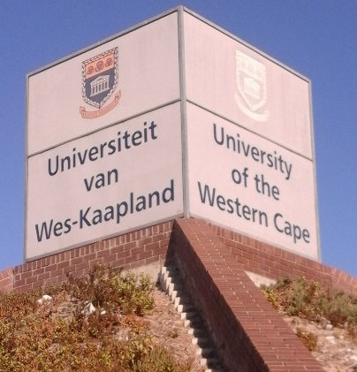
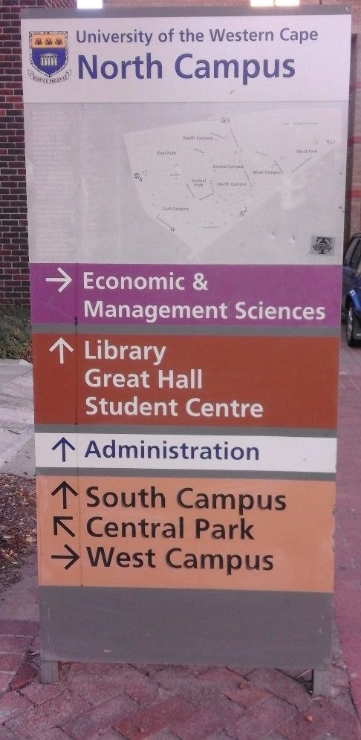
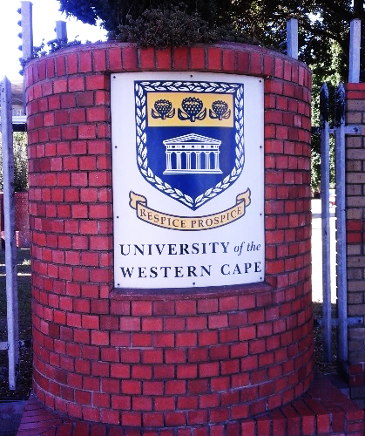
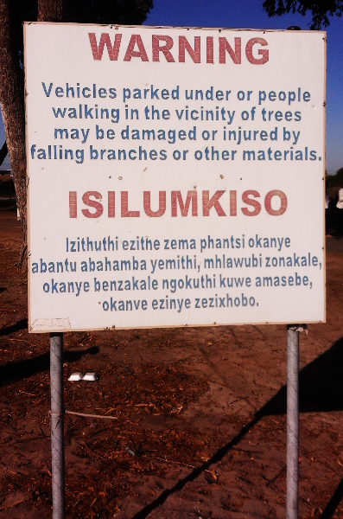
UWC LP: Signage
20
Examples of signage at UWC campus:

Slide 21
Four stages in the life-cycle of language policy and language planning (e.g. at national level)
21
Planning – data gathering, analysis of the language situation. Recommendations. Undertaken by commission of experts.
Policy formulation – governmental decision, typically based on a given political agenda. Undertaken by Parliament or relevant authority.
Implementation – putting the policy into practice and trying to enforce it (or NOT). Undertaken by government agencies, institutions, civil society groups, etc.
Evaluation – involves assessing the outcomes of the language planning effort – that is, whether and to what extent it has been successful
PLANNING
.
EVALUATION
POLICY FORMULATION
IMPLEMENTATION

Slide 22
Discussion
22
How are the multilingual arrangements in LCS 311 contributing to the implementation of UWC’s language policy?
Languages used in lectures, tutorials and practicals
Lectures, tutorials and practicals for any module will be delivered in the language formally approved by the Faculty concerned, in accordance with the spirit of the policy. If lecturers are competent users of other languages, they are encouraged to use these languages in addition to main language of teaching, if such a practice facilitates communication or discussion.
Languages used in the setting of tasks, assignments, tests and examinations
Regarding the languages used in the setting of tasks, assignments, tests and examinations, English, Afrikaans and Xhosa should be used wherever it is practicable to do so.
Languages used in writing tasks, assignments, tests and examinations
Unless otherwise negotiated between a student or a class and a lecturer, the language in which tasks, assignments, tests and examinations should be completed shall be English.

Slide 23
Three types/dimensions of language planning (which are frequently also addressed by policy)
23
Status planning – decisions on functions languages are to play; in education, it could involve introducing indigenous languages in education to perform a variety of roles (as medium of instruction, support languages e.g. in tutorials, etc.).
Corpus planning – developing indigenous languages and materials (orthographies, grammars, dictionaries documenting existing words, terminologies, style guides, texts); in education, it could involve massive creation of terms and writing/translating of texts.
Acquisition planning – strategies for ensuring that the language spreads or gains new users. How to prevent intergenerational language loss? How to create opportunities and incentives for people to use certain languages? How to teach languages in schools; and so on.

Slide 24
Assessing language policies using orientations/ideologies of language policy writers (Ruiz 1984)
24
Language policies can be assessed from the perspective of the orientation or ideologies of the policy writers towards language/multilingualism.
That is, according to Ruiz (1984), based on whether they view language/ multilingualism:
i. As a problem
ii. As resource
iii. As a right

Slide 25
Orientations/Ideologies of L policy writers…cont’d
25
Multilingualism is
(i) A problem: expensive, divisive, working against national unity, emphasizes difference rather than similarities.
Language policies based on this orientation view the existence of different languages as barriers or obstructions to social and educational development, so people need to be educated in the dominant language – the situation in post-colonial Africa.
Question: Do you agree that all people need to be educated in the dominant language?

Slide 26
Orientations/Ideologies of L policy writers…cont’d
26
(iii) A resource: Such language policies are based on the belief that diversity of languages are assets especially for trading purposes, for learning, tourism, for getting some form of advantage or the other.
How could multilingualism be an asset in learning?

Slide 27
27
Orientations/Ideologies of L policy writers…cont’d
(ii) A right: the (human) right to use own language in different domains.
Language policies based on this orientation: They emphasize issues like transmission of heritage, reduction of gap between home and school, benefits of ethnic diversity, e.g. SA Language Policy

Slide 28
Discussion Questions
28
Which of the orientations to ML most appeals to you? Why?
Download UWC’s language policy from iKamva. Identify as many provisions as possible in the policy that illustrate each orientation proposed by Ruiz (1984).

