Slide 1
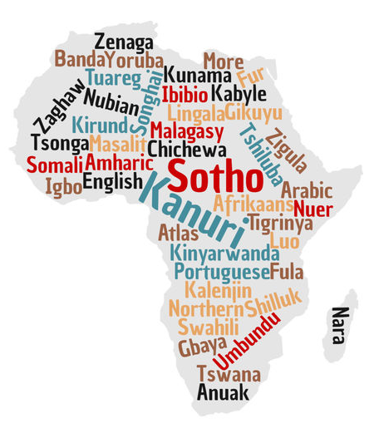
LCS 311 Multilingualism in Society and Education
Lecture 4:
Globalisation and Multilingualism
What globalisation-related factors are shaping/ influencing contemporary multilingualism?
[Course reader: pp13-16]

Slide 2
Recap: Lecture 3
Examined how different historical periods (modernity, late-/post-modernity; pre-colonialism, colonialism, postcolonialism, neo-colonialism) have responded to, or influenced views of, language and multilingualism.
That is, in terms of:
The way people use language
The way language is studied
The way society is organised around language
The beliefs about language in society or the attitudes to language(s)

Slide 3
Lecture 4 Outcomes: Aims
This lecture focuses on four factors related to globalization that are affecting language use and multilingualism at individual and societal levels.
So, at the end of this lecture, you should be able to...
demonstrate an understanding of globalization
mention a number of factors/issues associated with globalisation
describe how these factors/issues are affecting language use and multilingualism of societies as well as individuals.

Slide 4
What is globalization? Globalization is the process of integrating and
interacting among people and nations politically, economically and
culturally (Cameron 2001). Associated with the compression of space
and time, technological developments, mobility, socio-political and
economic re-arrangements, etc. (Antia 2000).
Wat is globalisering? Globalisering word gekoppel aan die kompressie van
ruimte en tyd, tegnologiese ontwikkelings, mobiliteit of te wel groter beweeglikheid, sosio-politieke en ekonomiese herrangskikkings, ens.
(Antia 2000).
Yintoni i-globalization? Ngokunxulumene noxinzelelo lwendawo kunye
nexesha, ukuphuhliswa kobugcisa, ukutshintsha-tshintsha iindawo,
iimeko zentlalo nezopolitiko, kunye nokulungelelaniswa kwezoqoqosho,
njl njl. (nguAntia, 2000).

Slide 5
Globalization-related factors shaping/ influencing multilingualism
Information & communication technologies (ICTs)
Migration
New workplace arrangements
New socio-political arrangements

Slide 6
Globalization-related factors shaping/ influencing multilingualism (continued)
Information & communication technologies and multilingualism. Instant interaction 24/7 through various modalities and media (Facebook, Whatsapp, Mxit, Blackberry Messenger, Gmail, Yahoo Instant Messenger, Skype, etc.) which exposes us to different languages, varieties and registers.
Informasie & kommunikasie tegnologieë en veeltaligheid. Onmiddellike interaksie 24/7 deur verskeie modaliteite en media (Facebook, Blackberry Messenger, Gmail, Yahoo Instant Messenger, Skype, ens.) wat ons blootstel aan verskillende tale, variëteite en registers.
Ubugcisa bolwazi nonxibelelwano, kunye nokusetyenziswa kweelwimi ezininzi. Indlela ekhawulezayo yokusebenzisana maxa onke, ngokusebenzisa iindlela ezohlukeneyo zonxibelelwano kunye nosasazo (u-Facebook, i-Blackberry Messenger, u-Gmail, u-Yahoo Instant Messenger, u-Skype, njl njl.), ezithi zisidibanise neelwimi ezohlukeneyo, iintlobo zazo kunye nezithetho zabantu abasendaweni ethile.

Slide 7
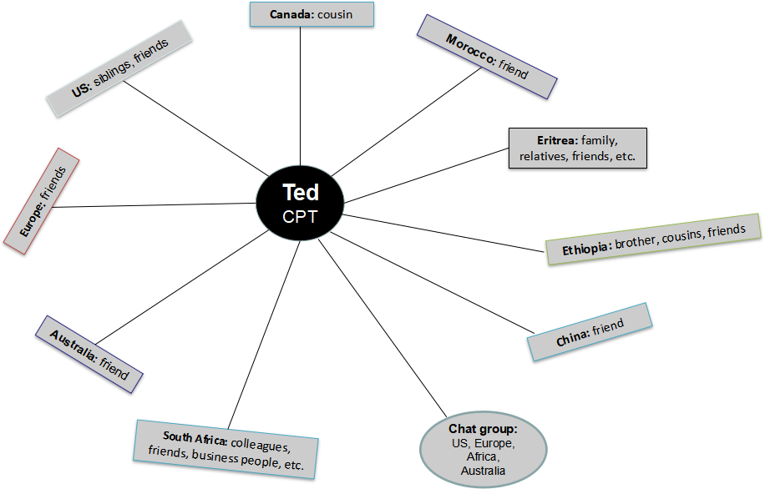
Tigrinya, English
Tigrinya, English
English, Arabic
Tigrinya, English
Tigrinya, English
Tigrinya, Amharic, English
Tigrinya, English
Tigrinya, Tigre, Arabic, English
English, Tigrinya, Amharic, Arabic, Afrikaans, isiXhosa
Tigrinya, English, Geez
Tigrinya
English
3. Arabic
4. Amharic
5. Afrikaans
6. isiXhosa
7. Tigre
8. Geez

Slide 8
2. Migration and multilingualism. Today’s technologies of communication and transportation “have made possible a density and intensity of links not seen before” (Chinchilla 2005:175, cited by Aronin & Singleton 2012:37).
Migrants to other countries now easily maintain contact with home regions, leading to the maintenance of the languages of the home region even in the diaspora; migration creates opportunities for languages to come into contact.
Migrasie en veeltaligheid. Moderne tegnologiee van kommunikasie en vervoer “het ‘n digtheid en intensiteit van verbindings moontlik gemaak wat nog nooit tevore gesien was nie” (Chinchilla 2005:175, aangehaal in Aronin & Singleton 2012:37). ​
Migrante na ander lande kan nou maklik kontak behou met hul tuislande, wat lei tot die behoud van die tale van sulke lande selfs in die nuwe lande waar hulle hul bevind; migrasie maak taalkontak moontlik.​
Ukufuduka nokusetyenziswa kweelwimi ezininzi. Ubugcisa bale mihla bonxibelelwano kunye nothutho “buye benza ukuba kubekho ingxinano nobuninzi beendlela zonxulumano ebezingazange zabonwa ngaphambili” (nguChinchilla ngo-2005:iphepha 175, ecatshulwa nguAronin noSingleton ngo-2012:iphepha 37). ​
Abafuduki abangena kwamanye amazwe ngoku bagcina unxibelelwano ngokulula kunye nemimandla yamakhaya abo, nto leyo ithi ikhokhelele ekugcinakaleni kweelwimi zaloo mimandla jikelele; ukufuduka kudala amathuba okuhlangana kweelwimi. ​

Slide 9
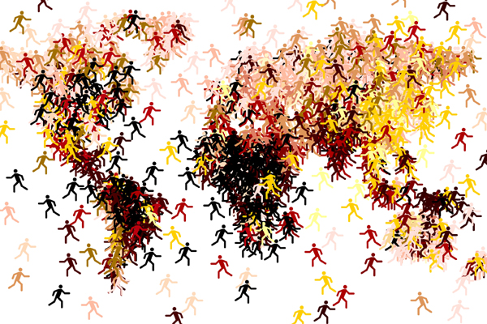
Migration and Multilingualism (cont’d)
These migrations are leading to the emergence of new or previously unrecognized mixed languages, especially in urban settings, which have become the home language of many of the urban migrant youth.
Olu fuduko luthi lukhokhelele ekumanyaneni kweelwimi ezixubeneyo, ezintsha okanye ebezifudula zingananzwa, ingakumbi kwiimeko zasezidolophini, nezithe zaba ziilwimi zasekhaya kulutsha oluninzi olufudukele ezidolophini.
Sulke migrasies lei tot die verskyning van nuwe of voorheen onerkende gemengde kodes, veral in stedelike ruimtes, en hierdie gemengde kodes het die huistale geword van veral jeugmigrante.​
Source: https://www.google.com/search?client=firefox-bd&biw=1098&bih=853&tbm=isch&sa=1&ei=vbB3XJGbIsuHjLsP_tuLsAU&q=globalization+migration&oq=globalization+migration&gs_l=img.3..0j0i24l4.8458.12635..12939...0.0..0.351.2887.2-9j2......0....1..gws-wiz-img.......0i67j0i8i30j0i30j0i5i30.F49kRzo8WlE#imgrc=eyNrWa24G8mnCM:

Slide 10
3. New workplace arrangements & multilingualism.
Technology has influenced work-place arrangements – some people now work from home, in part or fully; this leads to a blurring of work and home.
Consequently, languages, varieties or styles previously associated with the home environment are more easily brought in contact with speech forms associated with the office (i.e. convergence of home and work in terms of language use)
Amalungiselelo endawo entsha yomsebenzi kunye nendlela yokusetyenziswa kweelwimi ezininzi. Ubugcisa bube nefuthe ekulungiseleleni indawo yomsebenzi – abantu ngoku bakholisa ukusebenzela amakhayeni abo, nto leyo ithi ikhokhelele ngandlela ithile okanye ngokupheleleyo ekuphazamisekeni komsebenzi kunye nekhaya, nokuthi kukhokhelele ekuhlangabezaneni okanye ukudibana kwamathuba okusetyenziswa kweelwimi. ​
Iilwimi, iintlobo zazo okanye izitayile ebezifudula zisayanyaniswa nekhaya, zithi zidityaniswe ngokulula kwiindlela zokuthetha ezayanyaniswa nee-ofisi. ​
Nuwe werksopsette & veeltaligheid. Tegnologie het bepaald ons beskouiing van huis en werk ge-affekteer. Mense werk nou meer gereeld van hul huise af, gedeeltelik of ten volle. Dit het die skeidslyne tussen huis en werk laat vervaag, wat gelei het tot ‘n sameloping van taalgebruiksmoontlikhede.​
Tale, varieteite of spraakstyle voorheen kenmerkend van die omgewing van die huis word nou makliker in kontak gebruik met spraakvorme wat tradisioneel sorteer onder werk of die kantoor.​

Slide 11
4. New socio-political arrangements and multilingualism. In support of economic globalisation we see superstructures like SADC, EU and BRICS emerging, as well as the birth of new nations like South Sudan.
This has resulted in many more languages being in contact in official settings, the revival of previously threatened languages, and the greater acceptance of marginalized codes, with language blending becoming much more common.
Ulungiselelo olutsha lwezentlano nezopolitiko​: Ngokuxhasa i-globalization yezoqoqosho, sithi sibone amaqumrhu amakhulu afana ne-SADC, i-EU kunye neBRICS emanyana, kwakunye nokusekwa kwezizwe ezitsha ezifana noMzantsi Sudan. ​
Oku kukhokhelele kwiilwimi ezinizi ezithe zadibana kwiimeko ezisesikweni, ukuvuselelwa kweelwimi ebezikade zijongelwa phantsi, ukwamkelwa okumandla kweendlela zokunxibelelana ezicalulweyo, kunye nasekudibaneni kweelwimi ezohlukeneyo okuthe kwaxhaphaka ngokumandla.​
Nuwe sosio-politieke omstandighede​. Nuwe superstrukture wat ekonomiese globalisering steun het verskyn, soos SADEK, EU and BRICS, asook nuwe nasies soos Suid Sudan.​
Dit lei tot baie meer kontaksituasies vir verskillende tale in amptelike instellings, die herlewing van voorheen bedreigde tale, en ‘n groter aanvaardiging van gemarginaliseerde kodes, waarin taalvermenging meer algemeen voorkom.​

Slide 12
Summary
Globalization-related factors shaping contemporary multilingualism include:
Information & communication technologies (ICTs)
New workplace arrangements
Migration
New socio-political arrangements
Opsomming: Faktore verbonde aan Globalisering wat moderne veeltaligheid beinvloed sluit in:​
Informasie & kommunikasie tegnologiee (IKTs)​
Nuwe werksopsette​
Migrasie​
Nuwe sosio-politieke omstandighede​
Isishwankathelo: Imiba enxulumene ne-Globalization yendlela yelo xesha yokusetyenziswa kweelwimi ezininzi iquka: ​
Ubugcisa bolwazi kunye nonxibelelwano (ii-ICT ngamafutshane kwisiNgesi)​
Amalungiselelo amatsha endawo yokusebenza ​
Ukufuduka ​
Amalungiselelo amatsha ezentlalo nezopolitiko​

Slide 13
Discussion Questions: In the era of globalization, as people move around the world, they take their languages with them. What effect does globalization have on these languages? Discuss this question with reference to the experiences of people known to you.
What exposure have you had to non-local languages in your own environment? Have you picked up any words or expressions in these languages?
How do the changes in society arising from technology affect languages?
How is language contact promoted by socio-political arrangements?
Imibuzo yokuxoxwa:
Kwixesha le-globalization, njengokuba abantu betshintsha iindawo kwihlabathi jikelele, bahamba neelwimi zabo. Liliphi ifuthe enalo le globalization kwezi lwimi? Xoxa ngalo mbuzo ngokubhekiselele kumava abantu obaziyo. ​
Yintoni okhe wayibona nothe wayazi kwiilwimi ezingezo zalapha kindawo ohlala kuyo? Ingaba akho amagama okanye iintetho ozibambileyo kwezi lwimi? ​
Ingaba utshintsho kuluntu oludalwa bubugcisa luzichaphazela njani iilwimi? ​
Ingaba ukudibana kweelwimi kukhuthazwa njani kukulungiselelwa kweemeko zentlalo nezopolitiko? ​
Vrae vir bespreking: In die era of globalisering , soos mense rondom die wereld beweeg, neem hulle hul tale saam met hulle. Wat is die effek van globalisering op sulke tale? Bespreek hierdie vraag met verwysing na die ervarings van mense wat jy ken.​
Watter blootstelling het jy al gehad tot vreemde tale in jou eie omgewing? Ken jy enige woorde of uitdrukkings in sulke tale as gevolg van hierdie blootstelling?​
Hoe word tale beinvloed deur maatskaplike verandering as gevolg van tegnologie?​
Hoe bevorder sosio-politieke omstandighede taalkontak?​

Slide 14
Reminders
Essay 1 assignment: instructions and an example essay were posted in the Assignments tool on ikamva (please do check if you have not done so yet).
Submission date is 22 March
Tuts for 311 start: week of 07 March (This week)
(the task/questions will be posted on ikamva in the Assignments tool)
Tut Groups: have already been created; so, by now you should know your Tut Group and who your Tutor is.
If you do not, please let us know urgently

