Slide 1
Lecture 9
The Challenges of Multilingualism in Post-colonial African States
1
The relevant pages of the Course Reader are from p. 38 to p. 40.

Slide 2
Recap of Lecture 8
We were introduced to what language policy (LP) is
We examined four motivations that could be the basis for language policies, namely: identity, ideology, insecurity, and inequality
We familiarised ourselves with the 1997 South African Language Policy for Higher Education as well as the new 2020 policy, namely, The Language Policy Framework for Public Higher Education Institutions.
We also explored UWC’s Language Policy: including the provisions on languages of teaching, learning, and assessment plus the language policy pertaining to four other areas.
Furthermore, we discussed the stages in the life-cycle of language policy and planning: namely, planning, policy formulation, implementation, and evaluation and what each of them involves.
We considered three types of language planning: status planning, corpus planning, and acquisition planning.
Finally, we saw that language policies could be assessed in terms of the orientations of language policy writers: i.e. in terms of whether those who wrote the policy viewed language/multilingualism as a problem, as a resource, as a right.
2

Slide 3
Discussion points in today’s lecture on the challenges of multilingualism in post-colonial African States
Dominant languages in post-colonial Africa;
Some facts about language policy in post-colonial African states;
The agencies instrumental in imposing monolingual policies;
Implications of monolingual state language policies; and
Major challenges to using African languages in education.
3

Slide 4
Pre-lecture discussion questions
4
What is meant by post-colonial ...?
– the era after the colonized countries gained their independence (mostly in early 1960s).
it is Linked to the era/period of Post-modernity.
The next two questions are:
What do you know about language policy in post-colonial African states?
What are the dominant languages in Africa -- in other words, the languages which occupy the highest status and are used as the primary media in formal domains such as administration, education, and others?
By way of answering these two questions, let’s look at slides No. 5 and No. 6.

Slide 5
Some facts about language policy in post-colonial African states
5
The dominant colonial languages in most African countries are ex-colonial languages, especially, English, French, and Portuguese;
these ex-colonial languages are selected as official languages and as media of instruction in schools (especially at secondary and tertiary levels);
the above policy (i.e. languages selected) has led to a mismatch between national language policies and actual language practices of people on the ground;
This policy has also led to
African countries being referred to as “Anglophone,” “Francophone,” and “Lusophone” --(meaning, “English-speaking,” “French-speaking,” and “Portuguese-speaking, respectively) -- as if the majority of their population spoke English, French, or Portuguese.
As such, African languages are rendered invisible --i.e. made invisible, as if they do not exist.

Slide 6
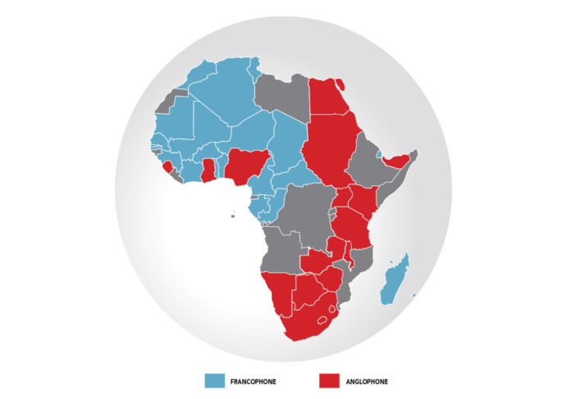
What ex-colonial language is dominant in which post-colonial African states? Which are the so-called “Francophone” and “Anglophone” post-colonial African states?
6
Source: https://www.screenafrica.com/2019/02/15/film/business/its-time-to-bridge-the-divide-francophone-anglophone-unite/
Source: http://exploringafrica.matrix.msu.edu/3061-2/

Slide 7
Agencies that are instrumental in imposing monolingual policies in post-colonial African Countries
7
1. African governments themselves, which are
– obsessed with the belief that “a single language unites a country”
– and see multilingualism as a potential cause for ethno-linguistic tensions and conflict (i.e. they believe that “multilingualism is divisive”).
2. International development organisations
such the World Bank, which prefer communicating in world languages like English and French.
3. Ex-colonial governments (such as Britain, France, and so on) and their various agencies which would want to continue to promote their own languages.

Slide 8
Why do you think ex-colonial countries would want their former colonies to adopt the ex-colonial language rather than a local language(s) as a medium of instruction?
8
1. For ex-colonial countries, having their own languages adopted as the only/dominant media in High function domains in their former colonies, is one way of keeping the local languages of former colonies under-developed, stigmatised as being worthless; unfit for formal domains, etc. and, thereby, instilling or maintaining feelings of inferiority among their speakers.
2. Ex-colonial countries can, and do indeed, benefit financially if their own languages are adopted in formal domains in the former colonies.
For example, when a particular former colony of France adopts the French language as the sole or dominant medium of instruction, that country is more likely to
- import textbooks and other educational materials from France
- hire (educational and language) consultants from France
- send many of its citizens to higher education institutions in France
- Etc.

Slide 9
In African countries, the adoption of monolingual policies can have serious implications
9
1. The majority of the population is excluded or marginalized
2. It is mainly the elite and their children can achieve academic access and, thus, economic success
3. African languages continue to suffer from negative attitudes and lack of opportunity to develop
4. In some cases, speakers of African languages shift towards ex-colonial languages, and
5. Even death/extinction of African languages

Slide 10
Major challenges that have to be overcome to use of African languages in education
10
1. Political and economic dependency on donor agencies
[Which influence language policies of the aid-receiving countries – by saying something like “We won’t give you X unless you use Language-Y as your main medium of instruction”]
2. Role of international text-book publishers
[Which indirectly through their own governments influence African language policies, so that they can continue to gain huge profits from exporting textbooks printed in English/French/Portuguese, etc.
3. Role of elites [who want to maintain power and use language for exclusionary purposes; to continue to enjoy the privileges associated with the ex-colonial language]
4. Different language ideologies of researchers and consultants (and also dominant language ideologies in these countries)
[such as “one-nation-one language,” “standard language” etc.]
5. Role of parents and their attitudes towards local languages [which is widely reported as being negative]

Slide 11
Think about the following questions!
11
1. What is the dominant official language in your country?
[If more than one, what are they?]
2. Is it an ex-colonal or a local language?
[If more than one, are they both ex-colonial or local, or a mix ]
3. What proportion of the populaton in your country speaks this dominant language/these dominant languages: is it the majority? About half? Or only a small proportion?
4. If only a small proportion, what are the implications/consequences of this situation on the majority of the population and on local languages?
- Think of those that were mentioned earlier on Slide No. 9, if applicable, and any others.

Slide 12
Thank you

